Slide 1
Elevating SQL Server Performance with Query Store Hints
Rui Carvalho

Slide 2







RUI CARVALHO
Data Engineer at DevScope
+6 years working with Data
Medium writer
Speaker

Slide 3
Landing on Query Store
It is a mechanism to store the history of plans of each query in a database.
Allows to force and unforce plans.
Survives server restarts and upgrades.
Captures performance over time.
Captures Execution and Wait statistics (SQL 2017+).
Gives the ability to choose what queries to capture.
Notes:
Let´s first land on what is Query Store and why it´s important.
It acts as a repository on your SQL Server database, and It's designed to store the history of execution plans for each query that runs.
One of the most important capabilities is its ability to force and unforce specific execution plans.
It survives server restarts and even upgrades. This means that the data it collects remains intact across these events.
It captures detailed performance metrics over time. This includes not just which queries were run, but also how they performed, giving you a window into the execution and wait statistics.
It also provides granular control over what queries you capture so you can focus on the queries that are most critical to your application's performance.

Slide 4
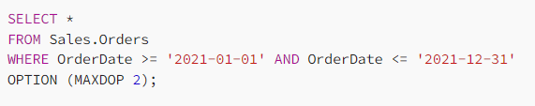
What is a Hint?
Instruction sent to the SQL Server query optimizer that influences the execution plan chosen for a specific query.
Examples:
MAXDOP
QUERYTRACEON
IGNORE_CONSTRAINTS
NOLOCK
RECOMPILE
Etc…
Used to address performance issues or fine-tune query execution when the optimizer does not produce the most efficient plan.
The MAXDOP hint can be used to limit the number of processor cores used to execute a query.
Notes:
And now, what is a hint?
Hints are instructions sent to the SQL Server Query Optimizer that affect the execution plan selected for a particular query. They are used to adjust query execution when the optimizer is unable to produce the most efficient plan or to address performance issues.
Some examples are:
MAXDOP hint, which controls the degree of parallelism for query execution. NOLOCK for reducing locking contention, and RECOMPILE, which tells SQL Server to generate a new execution plan for each execution. And there´s a lot more.

Slide 5
Why change Query behaviour?
Optimal Execution Plan Challenges.
Bad Plan Consequences.
Variable Cardinality Issues.
Memory Grant Size Limitation.
Adjusting Parallelism.
Notes:
Why change query plan behavior?
The engine should ideally choose a query's best execution strategy. It is intended to function in this way, but it doesn't always do so. In these situations, a DBA might have to optimize for some circumstances; otherwise, we're left with a poor plan, and poor plans frequently result in poor performance.
Some reasons are:
Optimal Execution Plan Challenges: Despite the Query Optimizer's design to select the best execution plan, it doesn't always succeed, needing some intervention.
Bad Plan Consequences: An inefficient query plan can significantly degrade performance.
Variable Cardinality Issues: Situations like stored procedures with highly variable selectivity may require the use of a RECOMPILE hint to ensure optimal execution.
Memory Limitation: For heavy operations, it might be necessary to constrain memory usage to prevent resource contention.
Parallelism: Limiting the maximum degree of parallelism is essential for reports running alongside critical environments to avoid performance hits.

Slide 6
Query Store Hint
Extension of Query Store.
Only on SQL Server 2022.
Add query-level hints to the execution plan generated by the SQL Server query optimizer without changing the original query text.
How it works?
Notes:
And then we arrive at Query Store Hint:
It´s basically an extension of Query Store that was launched on SQL Server 2022.
And the main goal is without changing the original query text, add query-level hints to the execution plan produced by the SQL Server.
How it works?

Slide 7
Query Store Hint
Query Executed
Query captured in Query Store
How to do this?
DBA creates a Query hint on a Query
Query executes using Query Store hint
Notes:
First, the query must be executed.
The query plan, and execution details are then captured into the Query Store.
The DBA creates a Query Store hint on a query using a specific procedure.
On the next execution, the query is executed using the Query Store hint.

Slide 8
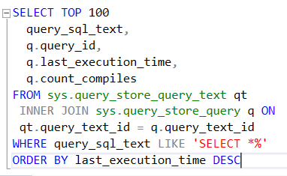

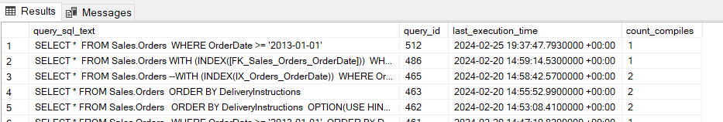
How to set a Hint?
Get the query ID of the query that you want to set a hint.

Slide 9

How to set a Hint?
With sp_query_store_set_hints and the query_id apply the hint you wish.
How to see all your Query Store Hints?

Slide 10
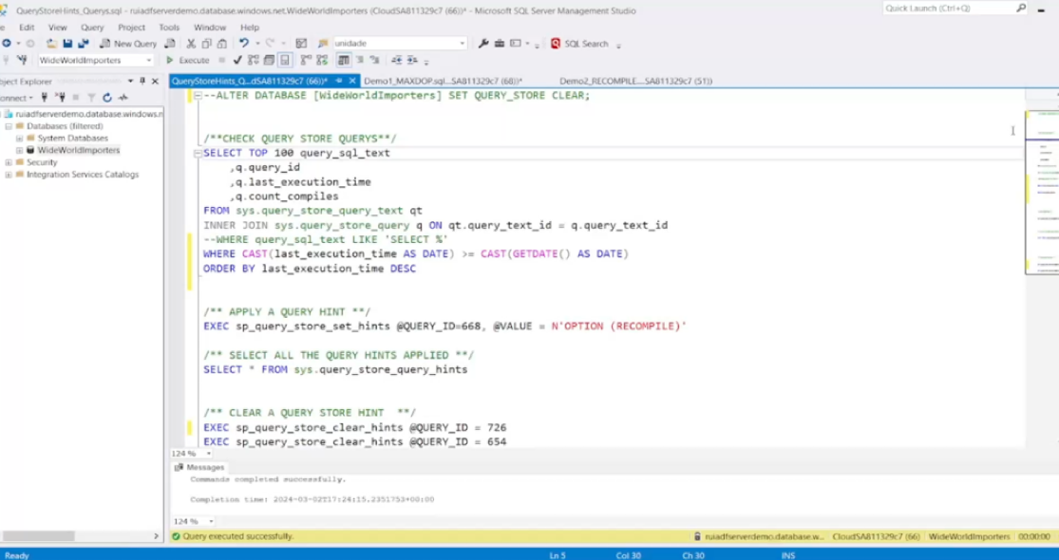
demo

Slide 11
Important Notes
Can write more than one HINT for a query.
Query Store Hints persisted after a restart.
Query Store Hints override any hard-coded statement-level hints and plan guide hints.
If a Hint is set but it contradicts what is possible, then the engine will execute the query ignoring the Hint.
Notes:
Important end notes:
Can write more than one HINT for a query in a single command by passing a string with all the hints you want to apply.
All the hints applied are persisted after a system restart.
Query Store hints take precedence over other types of hints, which means any hard-coded hints you might have in your SQL statements.
If a hint specifies an impossible action, the engine will ignore the hint for that execution and just execute the query normally.

Slide 12
Benefits
Fine-grained control over query execution plans.
No need to change query text.
Hint persistence.
Address performance issues more effectively.
Notes:
Benefits:
As we have seen:
We can have a fine-graine influence on SQL Server executes queries ensuring performance.
We can apply hints directly through the Query Store, avoiding modifications to application code.
Once we apply a hint to a query, it persists across server restarts.
Also, this approach allows us to address performance issues more effectively on the database's overall performance.

Slide 13


References
Hints (Transact-SQL) - Query
Query Store - SQL Server 2022
Query Store hints in SQL Server 2022
SQL Server 2022 Query Store Hints: Optimize Execution Plans for Enhanced Database Performance
I´ve a blog post about Query Store Hints ready for you

Slide 14

Feel free to approach me for any question
Or send me a message on linkedin or medium
Thank You!

Slide 16














